Slide 1
Applications in Public Key Directories
ENEE 759F/CMSC 818C
Blockchain and Cryptocurrency Technologies
April 4,2018
Anton, Khushali, Darshan
“Nakamoto”

Slide 2


So How Exactly do We Connect to the Internet? Or The First Few Milliseconds of an HTTPS Connection
“Hackers?
In my browser?”

Slide 3
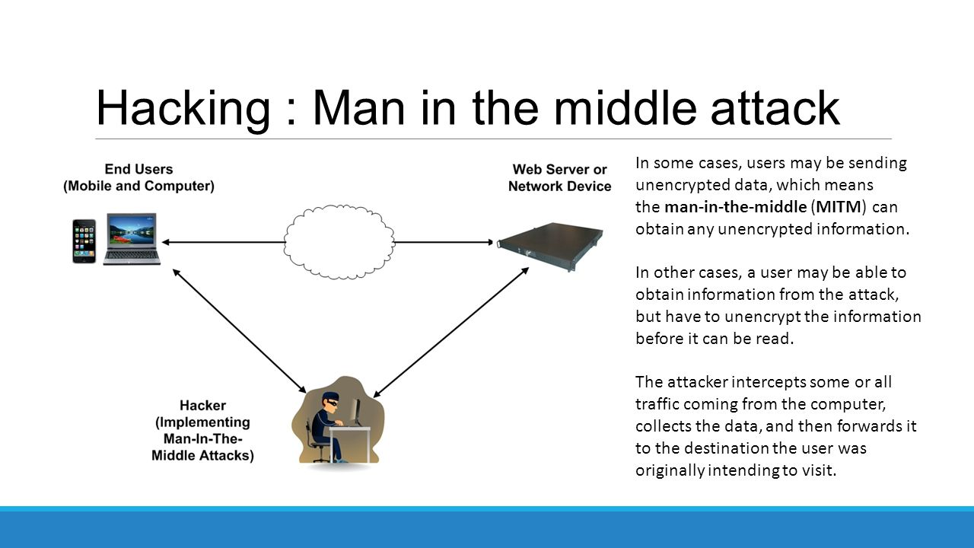

Slide 4
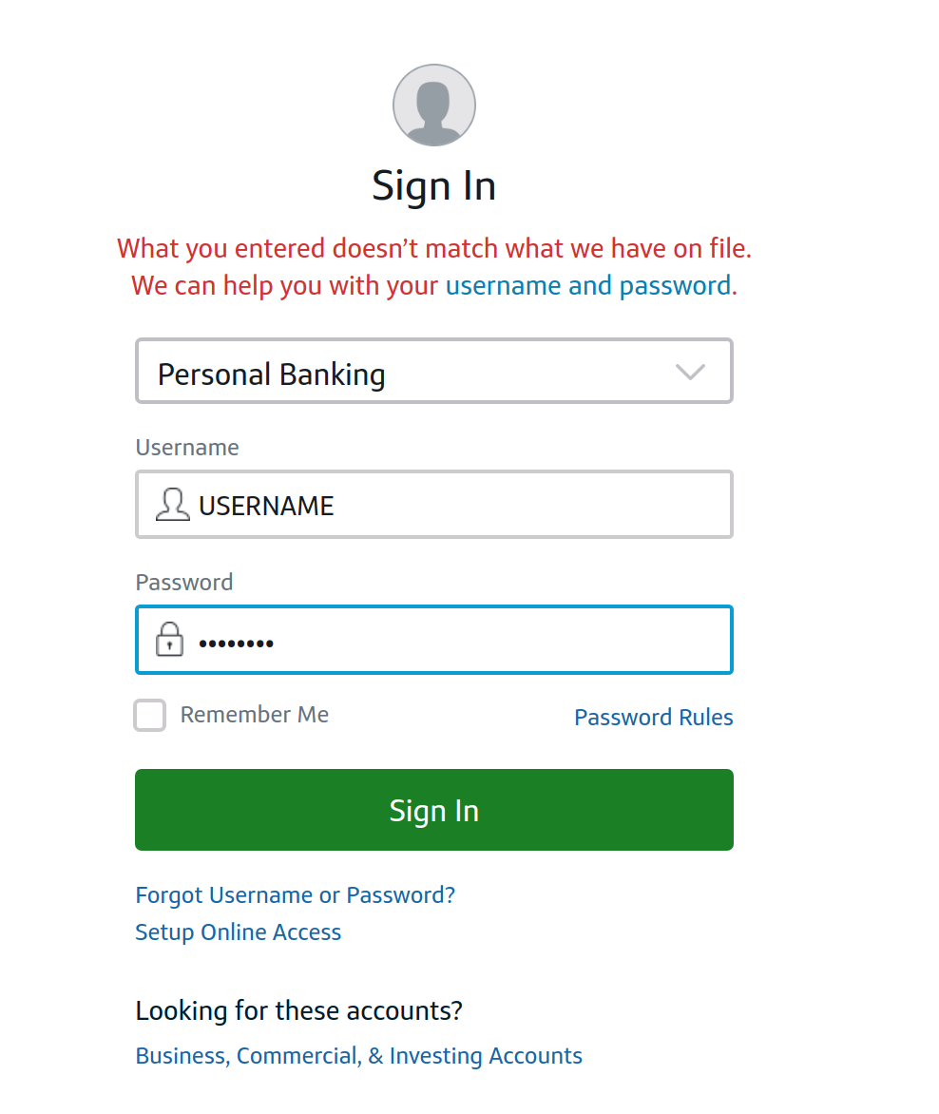
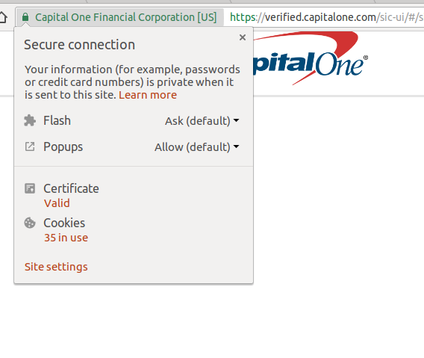
Says Who?

Slide 5
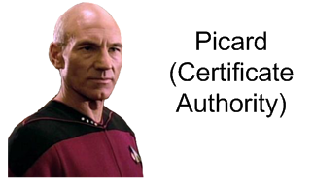
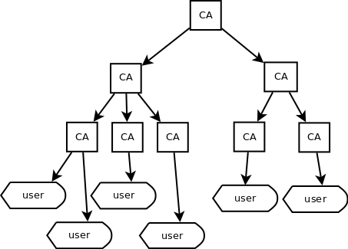
Let’s Have a Trusted Party!
PKI - Public Key Infrastructure
Creation, storage and distribution of Digital Certificates

Slide 6
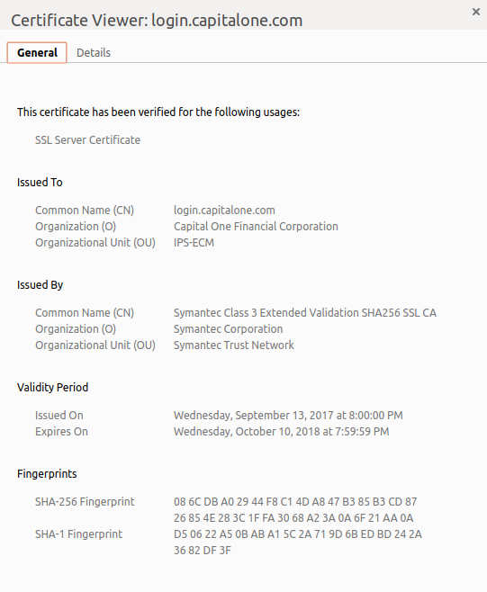
A Brief Intro to Certificates
Click here to see for yourself!

Slide 7
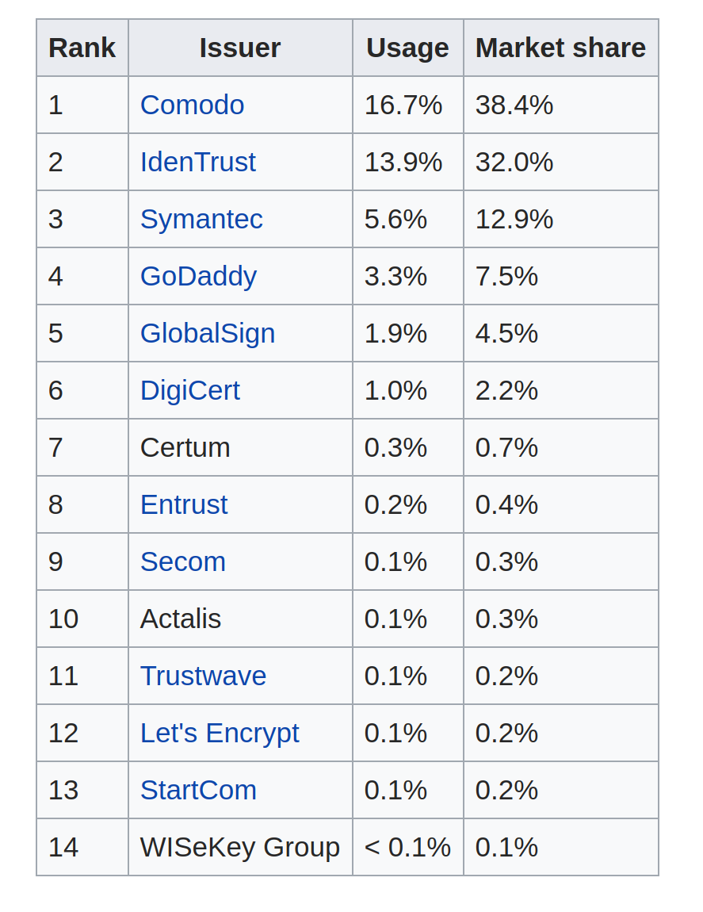
A Brief Intro to Certificates
Click here to see for yourself!

Slide 8
What can Bad Guys do?
Private keys get, well… stolen
“Analysis of SSL Certificate Reissues and Revocations in the Wake of Heartbleed”
A survey conducted on the most popular 1 million websites
60% do not revoke their vulnerable certificates
20% of those certificates will remain valid (not expire) for two or more years
In 2001 VeriSign issued two certificates to a person claiming to represent Microsoft
In 2011 fraudulent certificates were obtained from Comodo and DigiNotar, allegedly by Iranian hackers - and used in the man-in-the-middle attack
And many more...
Notes:
Heartbleed: http://www.cs.umd.edu/class/spring2017/cmsc818O/papers/heartbleed.pdf

Slide 9
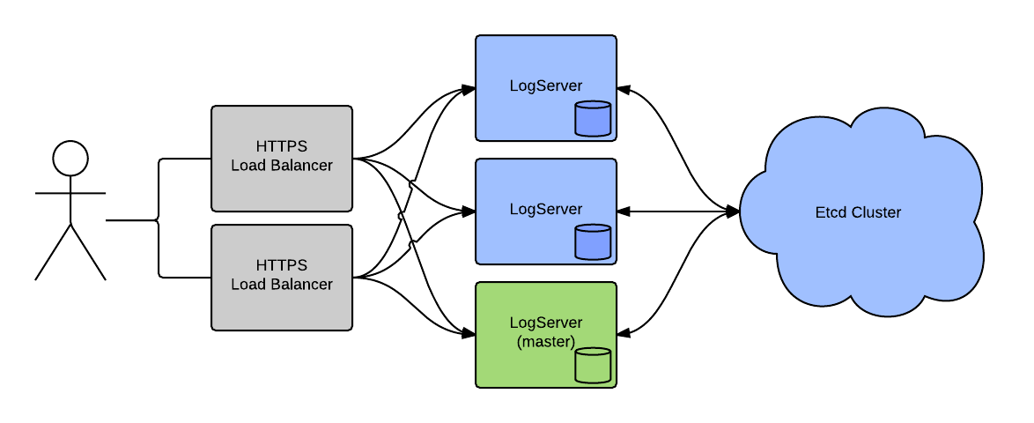

Certificate-Transparency:
Auditing for TLS certificates
open framework for monitoring and auditing SSL certificates in nearly real time
detect SSL certificates that have been mistakenly issued by a certificate authority
identify certificate authorities that have gone rogue
etcd is a distributed reliable key-value store
More info here: https://www.certificate-transparency.org
Notes:
Heartbleed: http://www.cs.umd.edu/class/spring2017/cmsc818O/papers/heartbleed.pdf

Slide 10
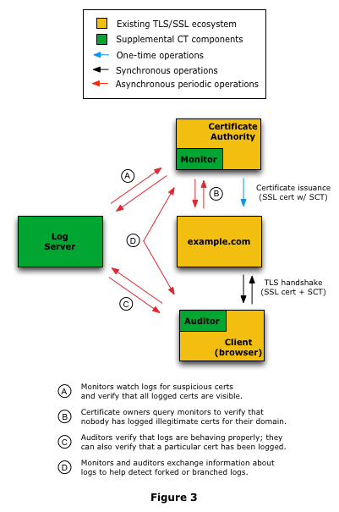
Certificate-Transparency:
Auditing for TLS certificates
More info here: https://www.certificate-transparency.org
Notes:
Heartbleed: http://www.cs.umd.edu/class/spring2017/cmsc818O/papers/heartbleed.pdf

Slide 11

The Dark side of CT
Who is running the logs?
Google is currently running most Certificate Transparency logs. We are trying to solve the problem of centralization with a centralized system!
http://www.certificate-transparency.org/known-logs (27 logs) - most Google, Symantec, Cloudflare, etc
Notes:
anyone can run a log, since the log does not have to be trusted

Slide 12

The Dark side of CT
Who gets benefited?
Neither who adds the certificate in the CT logs
Nor the browser vendor.
Reporting Process is complicated and is not incentivized
Notes:
Increasing the number of CT logs increases the cost of monitoring for domains and auditors

Slide 13
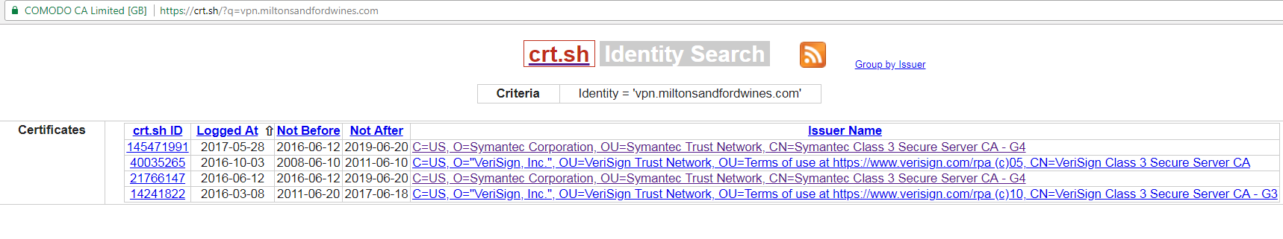
The Dark side of CT
So What About Privacy?
You can lookup any certificate:
The issue of privacy is an active research topic:
“Certificate Transparency with Privacy”, Saba Eskandarian et. al - Aug 2017 (arxiv)
Notes:
Certificate disclosure of Internal host names.

Slide 14
Let’s Put All Certificates Into the Blockchain!
Block
Block
Block
Block
Block
Blockchain
It is like the Certificate Transparency, but decentralized...
The monitors / auditors are miners… and they get payouts for finding invalid certificates!

Slide 15
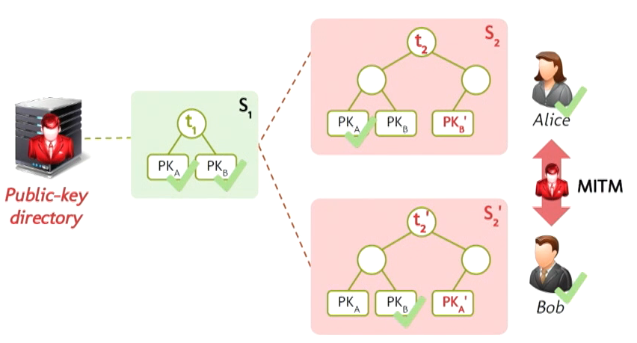
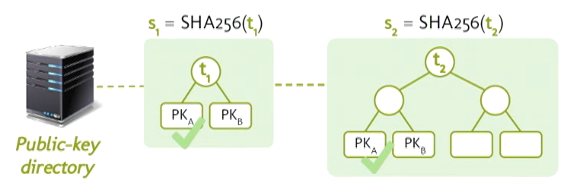
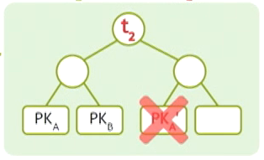


Catena: Efficient Non-equivocation via Bitcoin
Alin Tomescu & Srinivas Devadas, 2017
What is Non-equivocation?
Bitcoin-based append-only log
Hard-to-fork as the Bitcoin blockchain
Efficiently Auditable
600bytes/statement
80bytes/Bitcoin block
35Mb of Thin Client Memory to store Block Headers agains over 80Gb for Thick clients
Applications Public-key Distribution, Tor Directory Servers, Software Transparency Schemes
What is Equivocation?

Slide 16
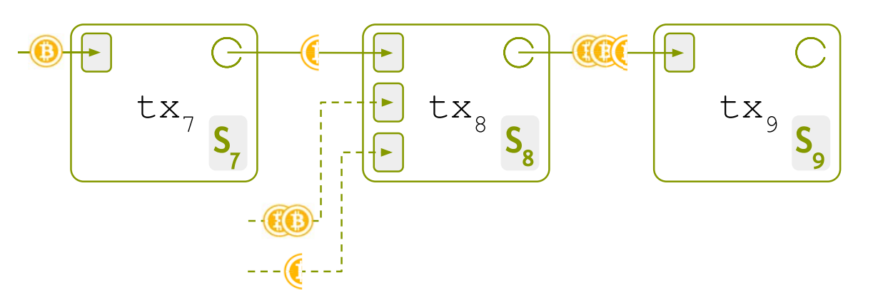
Working
Uses Provably Unspendable ‘Null Transactions’
Uses 80bytes of Data available for storing statements
Ensures a linear flow, thus ‘Non-Equivocation’
Support for Refunding the account
Operations:
CreateLog(d)
AppendStmnt(sk,si)
VerifyStmnt(pk,i,si)

Slide 17
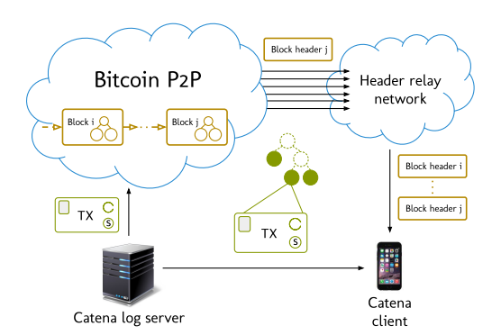
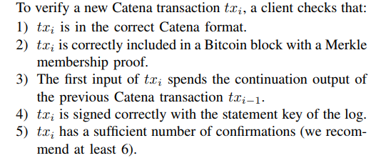
Architecture

Slide 18
Attack Models and Implementation Details
Log Server Attacks
Accidental Forks
Many Simplified Payment Verification (SPV) Miners, skipped the Timeout Logic in July 2015.
Bitcoin P2P Network Attacks
Header Relay Network Attack
0.12$/statement against Keybase’s 0.07$/statement
But NO INCENTIVES!!!

Slide 19
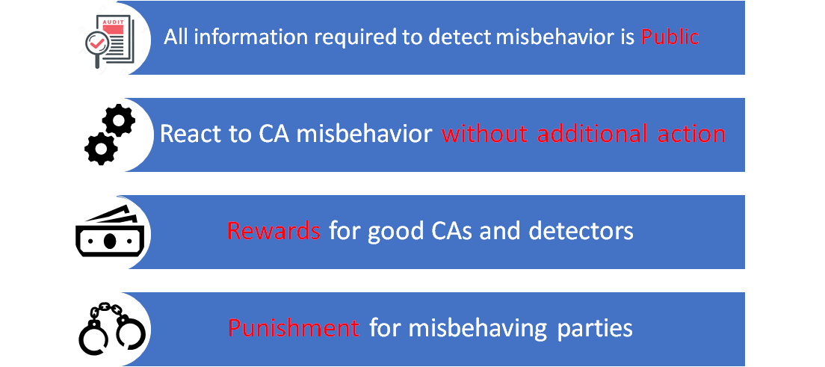
IKP: Turning a PKI Around with Blockchains
Stephanos Matsumoto and Raphael M. Reischuk, 2017

Slide 20
IKP: Overview
Block
Block
Block
Block
Block
Ethereum Blockchain
Reaction Policy
Certification Authority
IKP Contract
Detector
Cert
Cert Fee ($)
CA
Domain
Client
Domain
Domain Control Policy
TLS Handshake
Client

Slide 21
IKP: Overview
Reaction Policy
“If anyone issues an unauthorised cert for Facebook.com, I’ll pay them $1000 and whoever finds such a cert will get $100”
Certification Authority
IKP Contract
Detector
Cert
Facebook
TLS Handshake
Domain Control Policy
“all of my Certificates must be signed by “Digicert” or by “IdenTrust”
Client

Slide 22
IKP: Architecture
Block
Block
Block
Block
Block
Ethereum Blockchain
Reaction Policy
Certification Authority
$
IKP Contract
Fee
Detector
RP
DCP
Cert
Cert
RP Fee
$
Goals:
Auditability
Efficiency / Automation
Incentivization
Deterrence
Domain
Domain Control Policy
TLS Handshake
Client

Slide 23
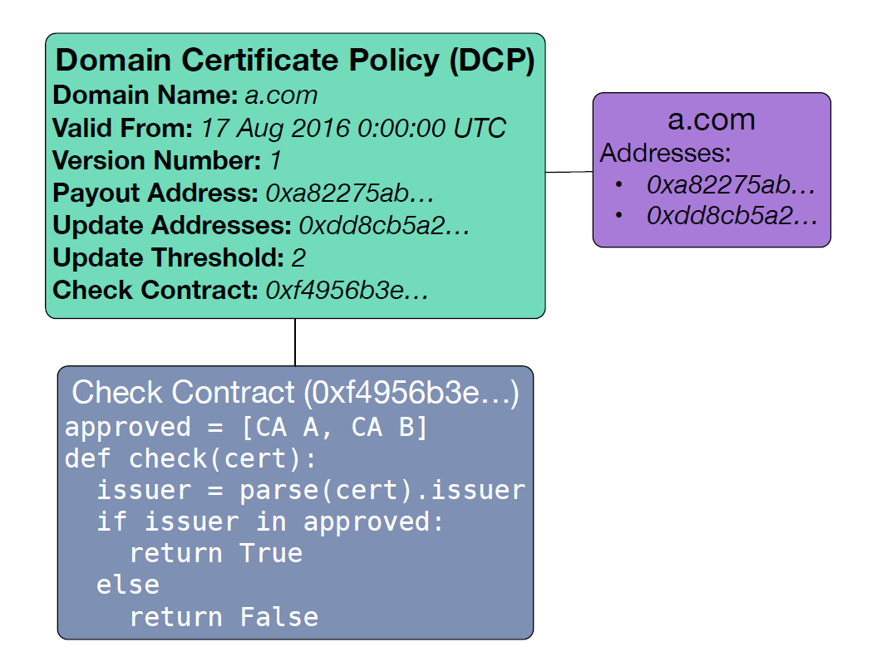
Types of Check Contracts:
CA Whitelisting
Public Key Pinning
Short Lived Certificates
Wildcard Restrictions
Certificate Transparency
Combination using Boolean AND, OR operators
Notes:
> State the 3 Design Principles for DCP:
Domain Specified Information
Blick-chain based storage
Policy Expressiveness
> DCP Contents
> Modular Check Contracts types

Slide 24
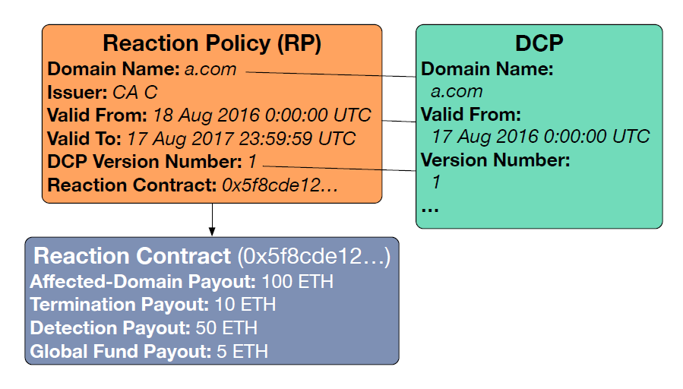
Design Considerations
Certificate Independence
Policy Adherence
Single Use

Slide 25
Working:
Block
Block
Block
Block
Block
Ethereum Blockchain
Reaction Policy
Certification Authority
IKP Contract
Global fund balance
CA Registry
RP Registry
Misbehavior report
Payout enforcer
Cert
Domain
Domain Control Policy
TLS Handshake
Client
Detector
Notes:
The IKP contract, which contains the logic to carry out the functions described in Section 4.2, including registering CAs and domains. The IKP contract also maintains its own balance used to escrow funds and to provide rewards. The contract exists exactly once in IKP and is responsible for all CAs, domains, and clients.
Affected-domain payouts. The affected-domain payout is paid to D in the event that any CA issues an unauthorized certicate in D's name.
Termination payouts. The termination payout is split between D and C if D terminates the reaction policy.
Detection payouts. The detection payout is the amount paid to whomever reports an unauthorized certicate for the domain to the IKP contract.
Global fund payouts.

Slide 26
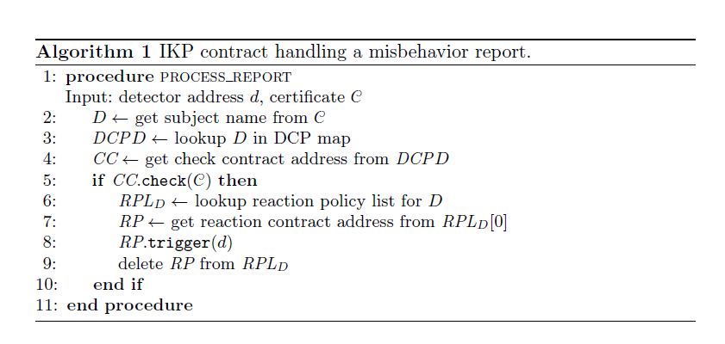
Handling Misbehaviour
Notes:
Frontrunning protection - Namecoin
\pre-report" containing the reporting fee and a commitment hash

Slide 27
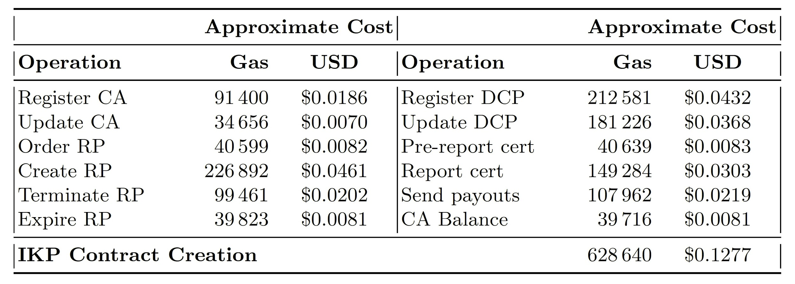
Cost Analysis
Coded in Solidity (166 lines of code)
For comparison, Namecoin - 10 lines of code
Verifying signatures is prohibitively expensive
* 20 Gwei = 2.03*10^-7 USD
*Current Price: 20Gwei = 8.28818*10^-7

Slide 28
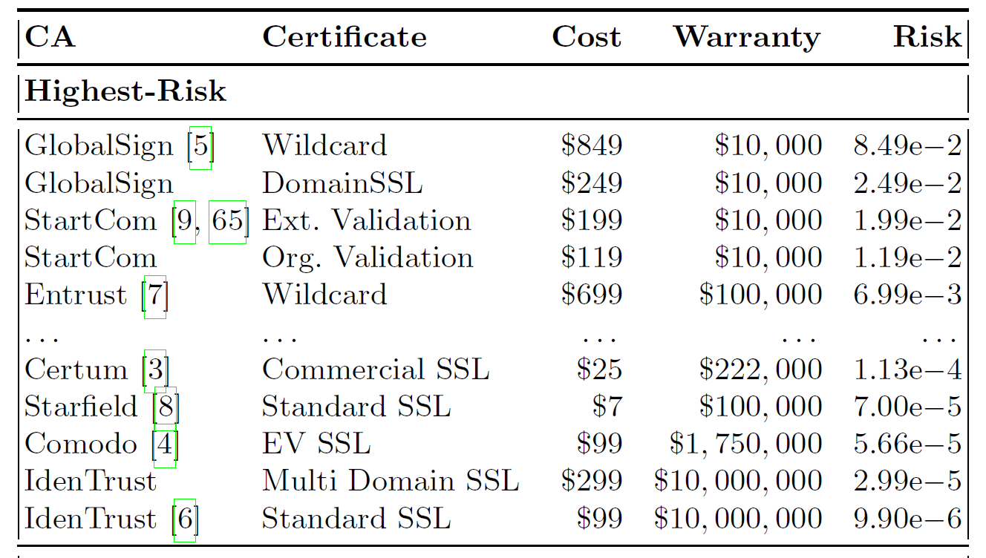
Cost Analysis
How much do the real certificates cost right now?

Slide 29
Conclusion
Blockchain technology is complementary to PKI
It has the capability to improve the efficiency and security of PKI without altering certificates or how they are validated
Blockchain’s public, distributed, and tamper-resistant nature is perfectly aligned with those of PKI and public key cryptography

Slide 30
Questions?

